Slide 1
Project DVT(Car_Claims)
File created on: 8/5/2024 9:40:07 AM

Slide 2
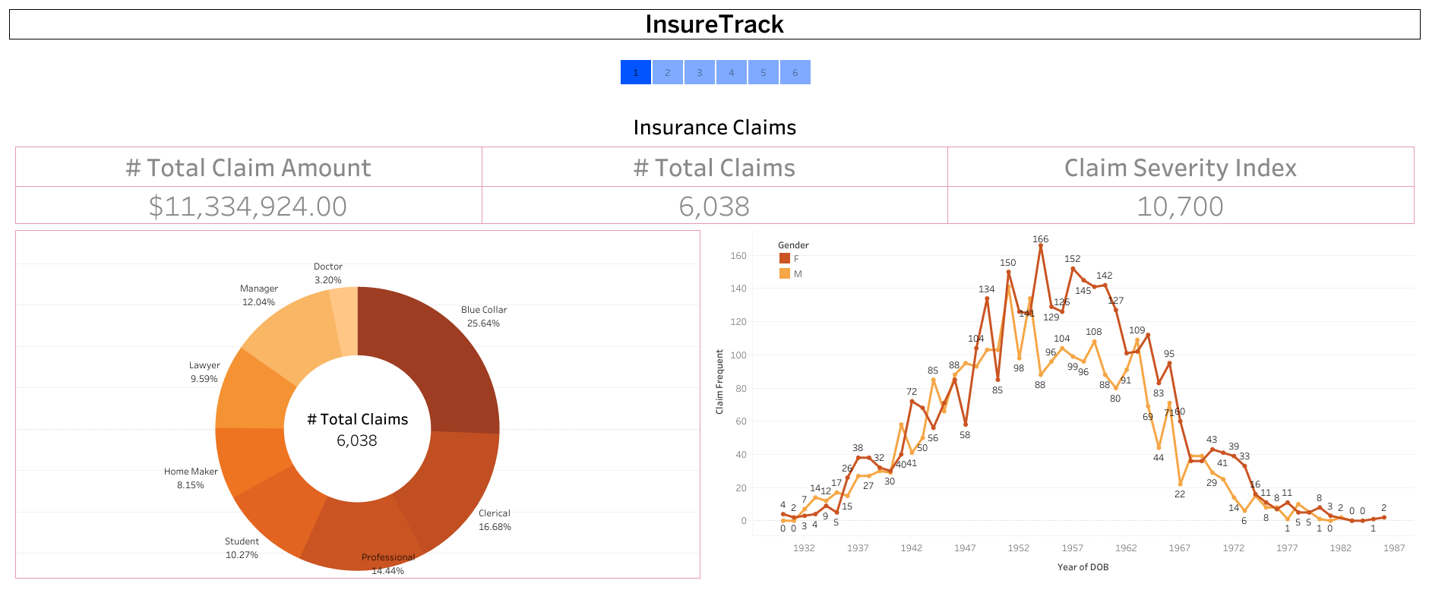

Slide 3
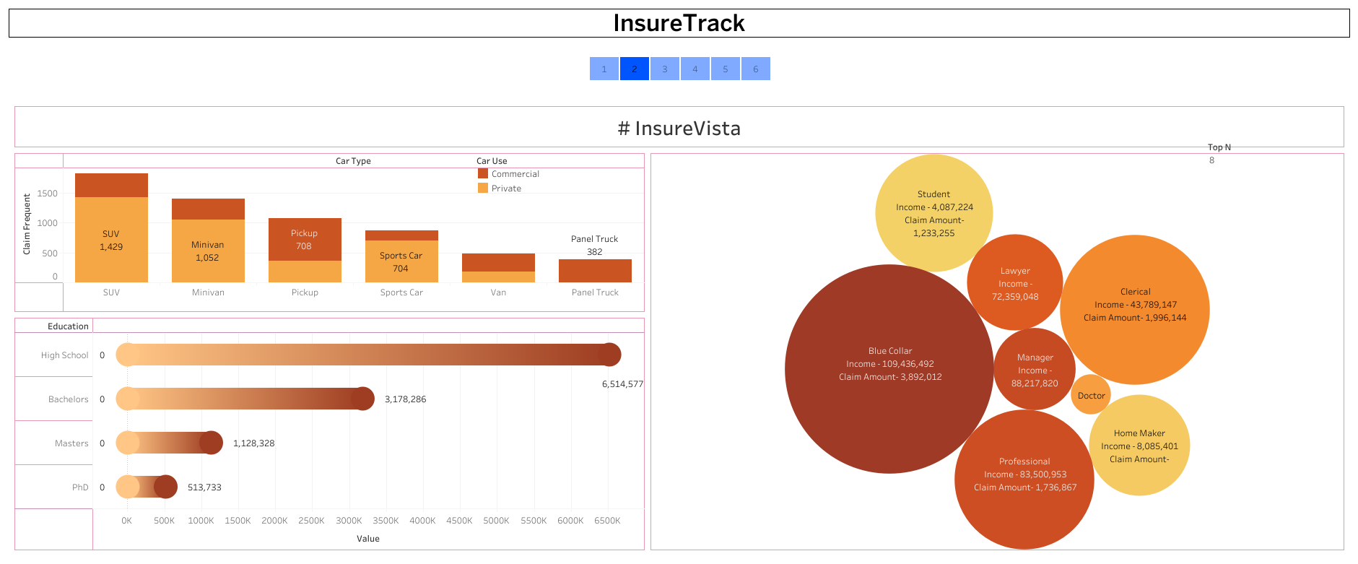

Slide 4
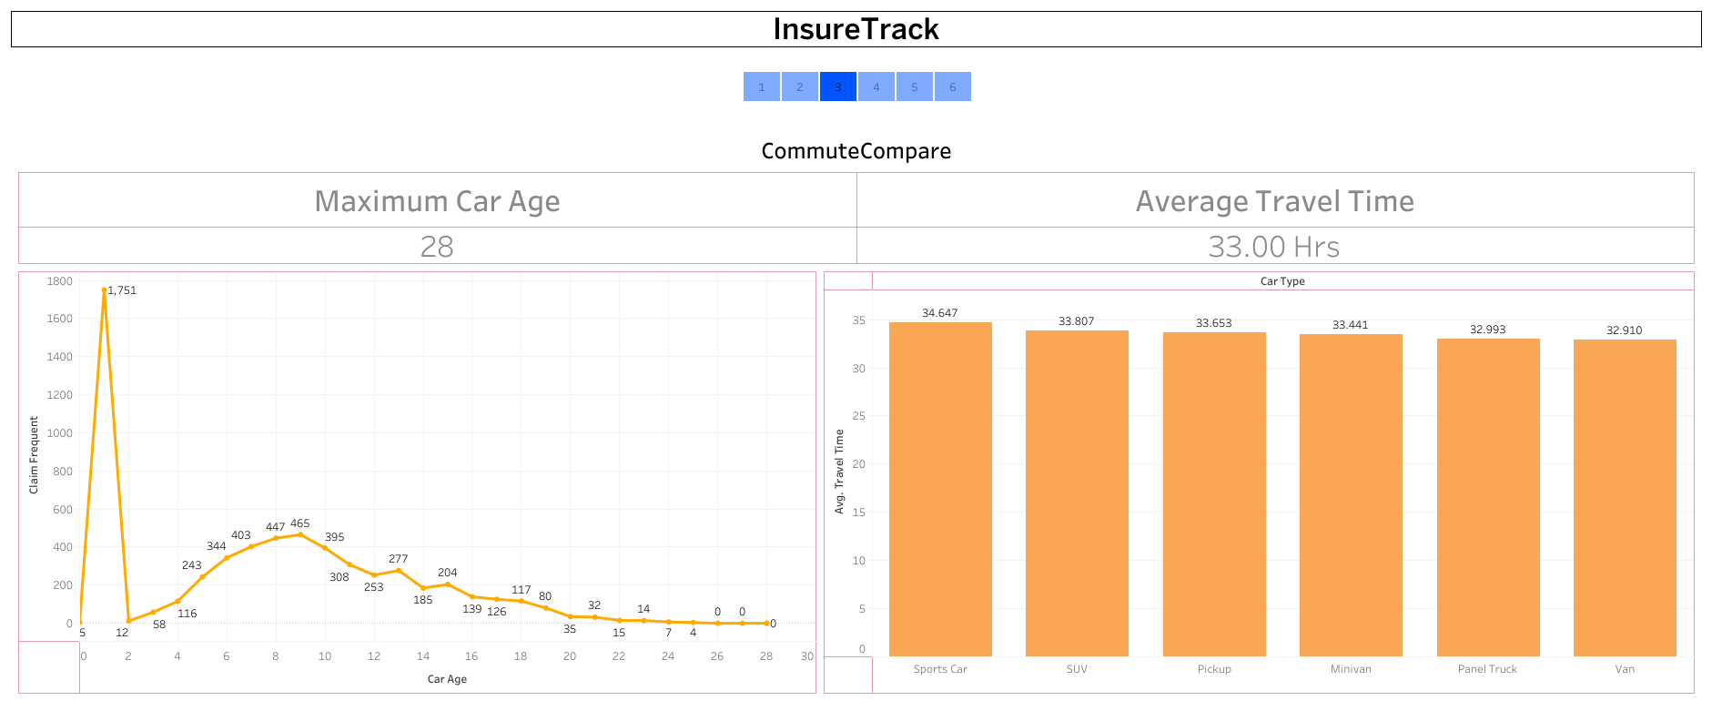

Slide 5
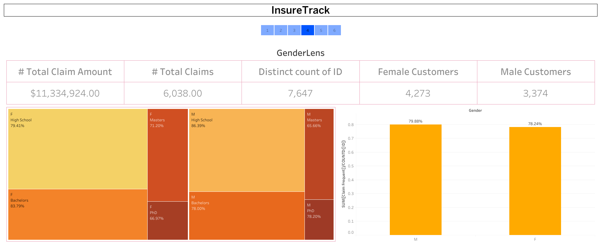

Slide 6
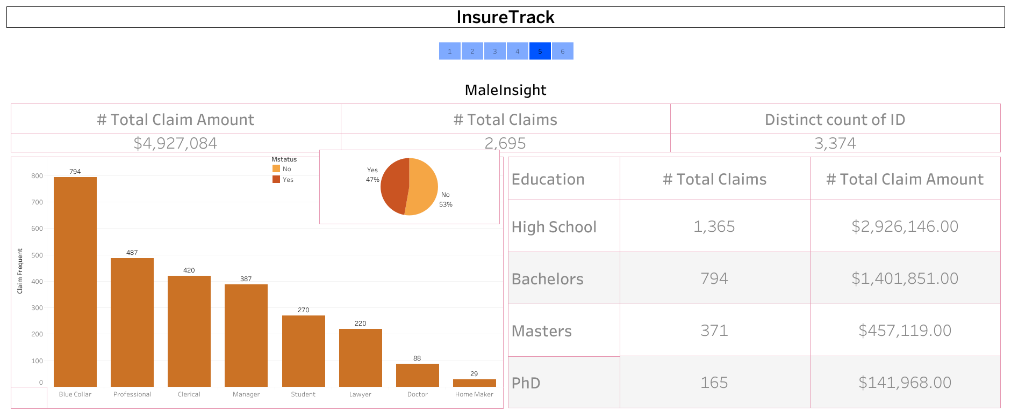

Slide 7
